Slide 1

Chapter 3
Iteration

Slide 2
Content
Control structures - iteration
While
Examples while
For with range
Examples for

Slide 3
Control structures
Each program is a combination of statements to be performed in
Sequential mode
Conditional mode
statement
statement
statement
True
statement
condition
statement
False
statement

Slide 4
Control structures
Each program is a combination of statements to be performed in
Repetitive mode (iteration, loop, repetition)
Statements can be grouped for reuse in logical blocks called
Functions (methods)
condition
statement

Slide 5
Iteration
The iteration is an elementary part of the program that consists of
an iteration condition
a component
The component is executed as long as (while) the condition is met.
The component may consist of several statements.

Slide 6
While
Syntax:
while condition:
statements
Procedure:
Evaluate the condition: result is True or False
If condition is false
leave the while loop
proceed to execute next statement
If condition is true
execute every statement of the body
go back to step 1
condition
False
True
body

Slide 7
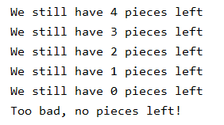
While
Example:
number = 5 while number > 0: number -= 1 print('We still have', number, 'pieces left') print('Too bad, no pieces left!')

Slide 8
Infinite loop
Pay attention! In the body of the iteration, the value of one or more variables checked in the condition-block must change so that the condition eventually becomes False. Otherwise the loop can never be terminated.
condition
False
True
body

Slide 9

Examples while
Add numbers (from 1 to ... ) as long as the total is less than 100
number = total = 0 #initialization is necessary! while total < 100: number += 1 total += number print('Sum of 1 to', number, '=', total)

Slide 10
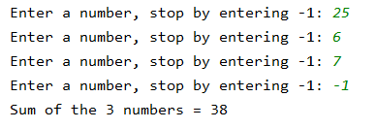
Examples while
Read and sum up numbers as long as you don’t read -1.
Print the number of numbers entered and their total.
total = count = 0 #read the first number before the while number = int(input('Enter a number, stop by entering -1: ')) while number != -1: count += 1 total += number #read the next number number = int(input('Enter a number, stop by entering -1: ')) print('Sum of the', count, 'numbers =', total)

Slide 11

Examples while
Determine the number of digits in a number
You can also write: number //= 10
number = int(input('Enter a number: ')) counter_digits = 0 #we must be able to remember the original number original_number = number
while number > 0: counter_digits += 1 number = number // 10 print(original_number, 'consists of', counter_digits, 'digits')

Slide 12
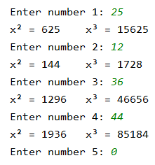
Examples while
Print the square and the third power of a number. Repeat this and stop by entering 0.
counter = 1 number = int(input('Enter number ' + str(counter) + ': ')) while number > 0: print("x² = " + str(number ** 2), "x³ = " + str(number ** 3), sep='\t') counter += 1 number = int(input('Enter number ' + str(counter) + ': '))
Tab character

Slide 13
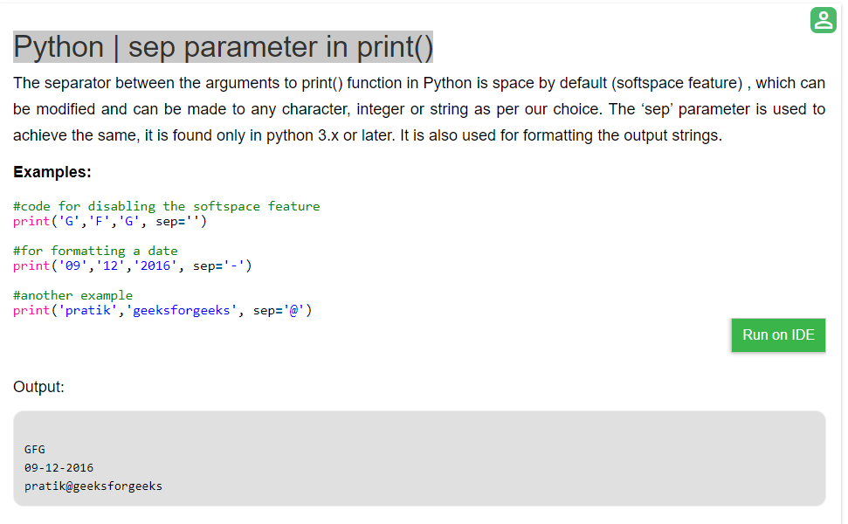
sep parameter in print()
https://www.geeksforgeeks.org/python-sep-parameter-print/

Slide 14
While versus for
If you use a while
there is always a condition that determines whether the component is repeated or not
you often don't know in advance how many times the component will be repeated
You can also use a for loop when:
the number of iterations is fixed in advance
you work with a range of numbers

Slide 15
For loop with range
range(y) all numbers from 0 to y but y not included
range(x, y) all numbers from the starting number x to the ending number y (y not included)
range(x, y, s) all numbers from x to y with step size s, i.e. the distance between the generated numbers. Default step size is 1.
Examples
range(7) 0, 1, 2, 3, 4, 5, 6
range(4, 11) 4, 5, 6, 7, 8, 9, 10
range(4, 11, 2) 4, 6, 8, 10
range(5, 0, -1) 5, 4, 3, 2, 1

Slide 16
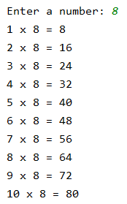
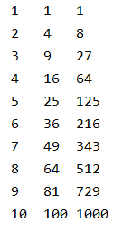
Examples for loop with range
Printing table of multiplication
Powers of 1 to 10
number = int(input('Enter a number: ')) for counter in range(1, 11): print(counter, 'x', number, '=', counter * number)
for counter in range(1, 11): print(counter, counter ** 2, counter ** 3, sep='\t')

Slide 17
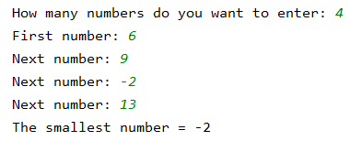
Examples for loop with range
Determine the smallest of a set of numbers
If you have to determine the smallest or largest, always take the first number as the starting value!
count_numbers = int(input('How many numbers do you want to enter: ')) smallest = int(input('First number: ‘))
for i in range(count_numbers - 1): number = int(input('Next number: ')) if number < smallest: smallest = number print('The smallest number =', smallest)

Slide 18


Nested for loops with range
for x in range(3, 5): for y in range(10, 50, 15): print(x, y)
for x in range(3, 5): print(x) for y in range(10, 50, 15): print(y)

Slide 19


Nested for loops with range
for x in range(3, 5): for y in range(x, 50, 15): print(x, y)
for x in range(3, 5): for y in range(10, 50, x): print(x, y)

Slide 20
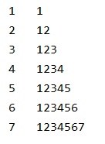
Nested for loops with range
We want to print:
for i in range(1, 8): print(i, '\t', end='') # print i + TAB and don't go to a new line for j in range(1, i + 1): print(str(j), end='') # print j and don't go to a new line print() # go to a new line

Slide 21
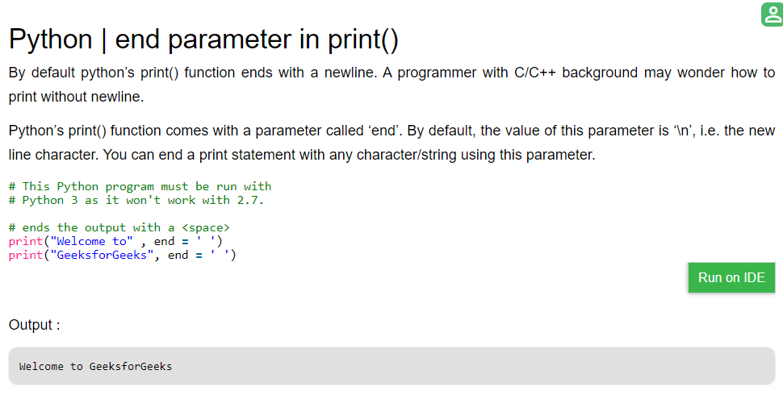
end parameter in print()
https://www.geeksforgeeks.org/gfact-50-python-end-parameter-in-print/Sdq

